Slide 1
National Fire Safety Week
Netherlands
Community Risk Intervention Team
16th April 2015
Ted O’Brien
Head of Operational Training & Development
Greater Manchester Fire & Rescue Service
Notes:
Welcome and thank you for the invitation

Slide 2
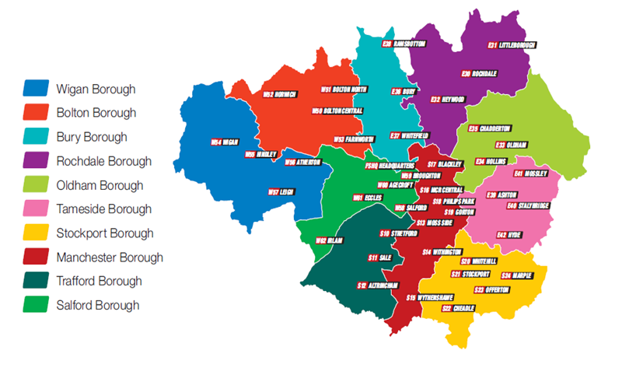
Introduction to GMFRS
Greater Manchester covers 10 Areas/Boroughs
Population 2.5 million people
Area 500 square miles
GMFRS have 41 Fire Stations and around 2,200 members of staff
Notes:
GMFRS overview

Slide 3
GMFRS Purpose & Aims
To protect and improve the quality of life of the people in Greater Manchester
Prevention
Engage with Greater Manchester’s communities to inform and educate people in how to reduce risk
Public value
Manage risk through using resources flexibility, efficiency and effectively
Notes:
In order to deliver this purpose we have set a number of Corporate aims which
are split into six key aims which support the achievement of our core purpose.
Prevention
Protection
Response
People
Principles
Public Value

Slide 4
Key Principles
We recognise that we must deal with the new financial reality… 21% Budget reduction
We want to keep Firefighters safe
We want to keep the Public safe…But!
We also want to continue to reduce fire damage and the cost of fire…
So the only way we can do this is by embracing change, adapting or adopting new technology
…and by changing fundamentally our approach to safety in the home and our wider community role

Slide 5
Performance - Response Activity
Notes:
Changed the thought process of Fires and Incidents attended being Preventable and None - Preventable to Accidental and None - Accidental
GMFRS believe that every incident is Preventable.

Slide 6
Impact of Home Safety Checks
Notes:
Of the 60 people who died in preventable dwelling fires within Greater Manchester, 45 of them lived in properties fitted with smoke alarms.
Only 25 of those properties however were protected by a working smoke alarm.
Of these 25 operational alarms it has to be considered that contributory factors such as the effects of alcohol and disabilities may have prevented the occupier from responding effectively when alerted.
It is therefore important that prevention activity is tailored to meet the needs of the individual as a one size fits all approach is not sufficient. GMFRS along with our partners must look at alternative solutions involving technology and specialist alarms such as the square wave alarm or equivalent.
Through our intelligence I can tell you – the age, ethnicity, of who's most likely to die in a fire – I can indicate where (borough, type of property, room in the house) and I can tell you the cause - My problem is that we don’t come into contact with the vast majority of them till they they have a fire !! –
This is where working with Partners and professionals is required.
6

Slide 7
Demand: Fire V Ambulance
Notes:
Demonstration of reduction in Fire Service activity and increase in Ambulance activity, and allows creation of capacity.

Slide 8
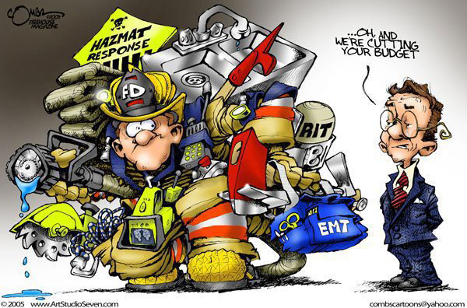
Changing Role of a Firefighter – ‘Latent Capacity’?

Slide 9
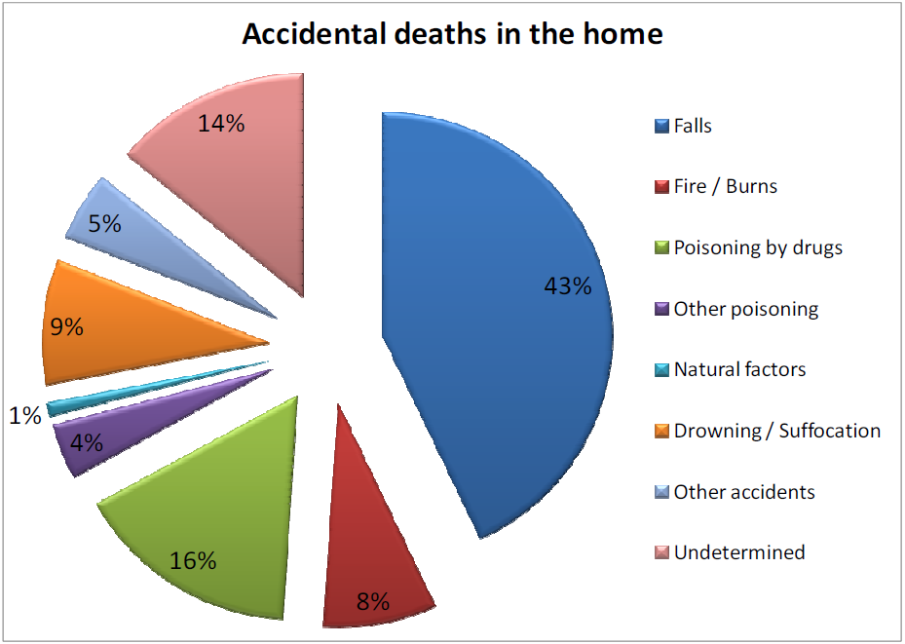
Where can we add value?
Notes:
Describe where the biggest risk is.

Slide 10
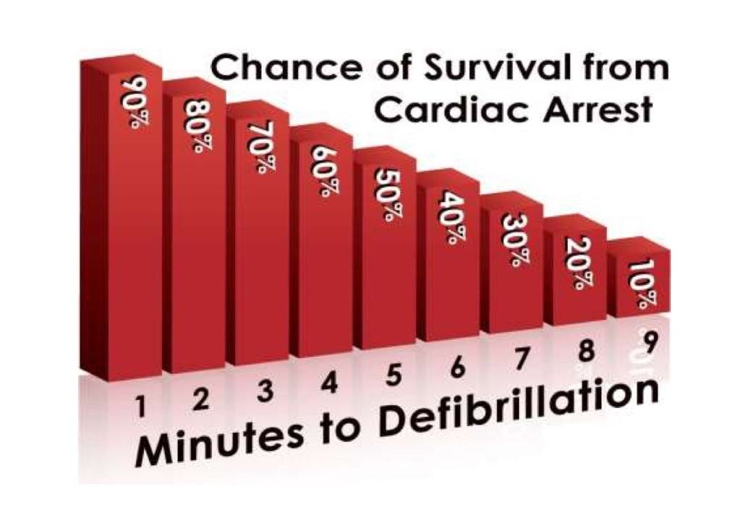
All Hazards Response?
Notes:
Fire Service already carry an AED on every front line appliance, and time is critical, link to current Fire Service attendance times.

Slide 11
“A thousand lives a year could be saved if firefighters responded to cardiac arrests with defibrillators”
Professor Andy Newton
Director of Clinical Operations, South East Coast Ambulance Service
“250,000 people a year cross the threshold of Accident and Emergency units as a result of falls”
Simon Stevens, CEO NHS England
Only 5% of those that suffer a cardiac arrest in Greater Manchester will survive, when this is attended by NWAS alone
NWAS Paramedic Trainer
Notes:
Support from NHS and Ambulance Service professionals.

Slide 12
Community Risk Intervention Team
Notes:
CRIT

Slide 13
What is the Business Case?
75% of calls to GMP not crime related
Pressure on North West Ambulance Service to meet attendance standards
Reputational impact for other agencies (GMP & NWAS) when low priority calls escalate in seriousness
Cost of primary and secondary care, reablement costs, on-going social care provision
Potential savings to Greater Manchester of £7.9M/pa by end of year two (already being exceeded)
Notes:
Provide descriptors around stats

Slide 14
Partners and Support
North West Ambulance Service
Greater Manchester Police
Greater Manchester Police and Crime Commissioner
GM Police and Crime Leads Group
GM Directors of Public Health
GM Public Sector Reform Executive
GM Health and Wellbeing Board
GM Directors of Adult Social Services
GM Strategic Safeguarding Partnership Board
GM Association of Clinical Commissioning Groups
University of Salford
Notes:
Extensive support of partners creates a true partnership approach to identifying those most at risk.

Slide 15
Pilot
Pilot in 3 Boroughs, Wigan, Salford and Manchester (Dec 14 – April 15)
Integrate fully with new Health & Social Care arrangements within Boroughs
Engage staff from GMP, NWAS and GMFRS volunteers, those returning from military service and Emergency Fire Crews that have engaged with GMFRS
Fixed term 20 hr/wk contracts to cover period 0700 – 1900 hours
Minimum 12 hr/wk out of hours cover provided through ‘on-call’ arrangements
Notes:
Describe Pilot details.
Explain how the Representative Bodies are resistant to utilising Firefighters for this role, however if we do not fill capacity then due to reduction in incidents it would see a reduction if Firefighters.
Rep Bodies have now acknowledged this and are in discussion and negotiation.

Slide 16
Activity
Prevention work 0700 to 1900 – focus on fire, falls, CO, crime and general detrition in health
Provide risk reduction equipment at point of contact and referral to specialists where appropriate
Response to Falls in the home on behalf of NWAS (manage risk with a view to casualty remaining at home wherever possible)
Response to Concern for Welfare relating to mental health on behalf of GMP
Response to Cardiac Arrests within a 3-mile radius of their location
Notes:
Describe what CRIT are doing.
Explain priority call handling, is the casualty breathing?, are they conscious?, are they responsive to noise, touch, pain delays response from the Ambulance.
Link back to Public Value.

Slide 17
Activity to 22 March 2015
CRIT Attendance Data
Borough | Response Activity |  |  |  |  | Total Response Activity | Prevention Activity | Total Combined Activity
 | North West Ambulance Service |  |  | Greater Manchester Police |  |  | Home Safety Check
 | Cardiac Arrests | Community First Responder/ other | Falls | Mental Health | Welfare Concern
Bolton | 5 | 9 | 6 | 0 | 1 | 21 | 2 | 23
Bury | 1 | 16 | 2 | 0 | 0 | 19 | 1 | 20
Manchester | 12 | 107 | 31 | 4 | 100 | 254 | 156 | 410
Rochdale | 0 | 2 | 0 | 0 | 0 | 2 | 0 | 2
Salford | 16 | 215 | 15 | 2 | 75 | 323 | 49 | 372
Stockport | 2 | 14 | 6 | 0 | 0 | 22 | 3 | 25
Tameside | 1 | 2 | 1 | 0 | 0 | 4 | 0 | 4
Trafford | 4 | 47 | 3 | 1 | 2 | 57 | 4 | 61
Wigan | 16 | 62 | 31 | 6 | 142 | 257 | 121 | 378
Oldham | 1 | 0 | 1 | 0 | 0 | 2 | 0 | 2
Total | 58 | 474 | 96 | 13 | 320 | 961 | 336 | 1297
Notes:
Describe mobilisations on behalf of GMP and NWAS.

Slide 18
Next phase for CRIT?
DCLG funding £3.73million awarded in April
Multi Agency Steering Group maturing
Expansion across Greater Manchester (one team per borough)
Firefighters being trained in April 2015
Independent evaluation (in live time) through Salford University
Cost Benefit Analysis through New Economy
Estimated £9 Million saving so far from an £898K investment (3 Months)

Slide 19
Thank you
‘To protect and improve the quality of life of the people in Greater Manchester’
Ted O’Brien
GMFRS
www.manchesterfire.gov.uk

